Slide 1


Technological Process Perfection
by employing Digital Twin

Slide 2
Industry Revolution 4.0
How does it change the World?
Digitalization / Big Data
Operational Efficiency
Large, complex data sets, difficult to process and analyze using traditional methods
Avoidance of human errors, quality and speed of control, demand based optimal production scenario
Intelligent Digital Twin Cloud Solution for industry
Regulation
Digital Twin / Simulation
Significant impact on the economy, transformation of the workforce skill sets
Makes products and services more accessible, transmissible and efficient
Realization of the digital transformation of the field, delivering real-time decision making, enhanced productivity, flexibility and agility to revolutionize the way companies manufacture, improve and distribute their products

Slide 3



Cognitive limitations
How many variables should be taken into account?
Human brain
4 variables are difficult; 5 are nearly impossible
Graeme S. Halford, Rosemary Baker, Julie E. McCredden (University of Queensland ) and John D. Bain (Griffith University)
Intelligent Digital Twin Cloud Solution for industry
Excel Solver
Microsoft Excel Solver has a limit of 200 decision variables
DCS
Distributed Control System (DCS) of Waste burning Power plant may have 7,265 or more measuring points

Slide 4




Intelligent
Digital Twin
Cloud Solution, designed to increase industrial process energy efficiency and reduce resource consumption through continuous monitoring and automatic process control according to real time data
Intelligent Digital Twin Cloud Solution for industry
Hardware vendor independent
No additional equipment required

Slide 5

Industrial process perfection
Intelligent Digital Twin solutions for different industries
REFRIGERATION
01
BIOMASS BOILER
01
Intelligent Digital Twin Cloud Solution for industry
BUIDING MANAGEMENT
02
VENTILATION
02
MALT & MILK POWDER DRYING
03
DISTRICT HEATING
03
WASTE TO ENERGY
04
PET BOTTLE BLOWING
04

Slide 6
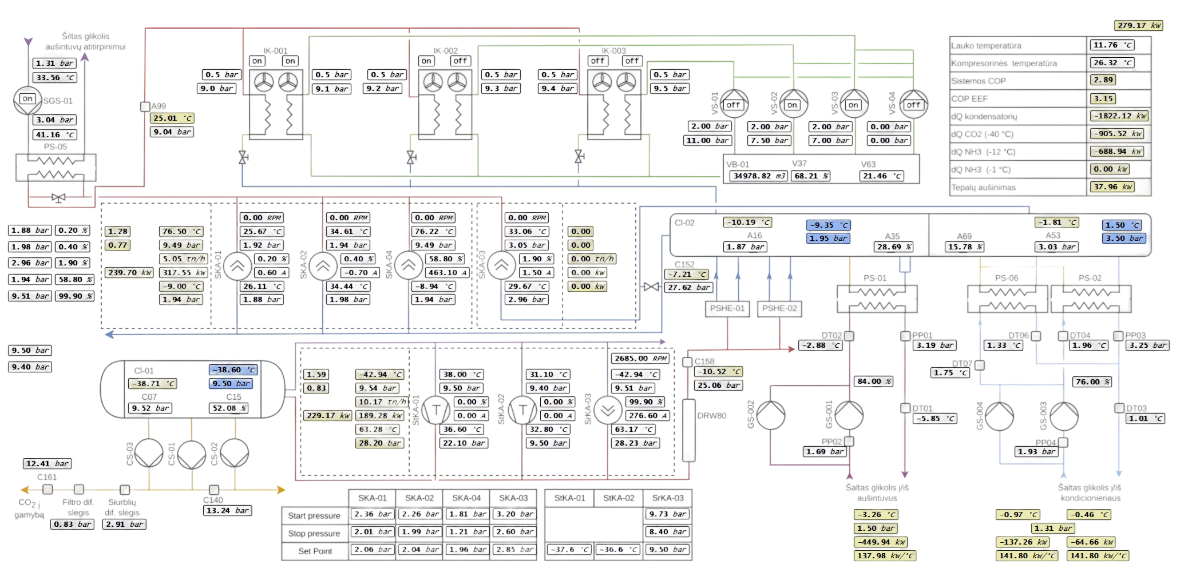
Example of a production plant
Machine room
Intelligent Digital Twin Cloud Solution for industry

Slide 7
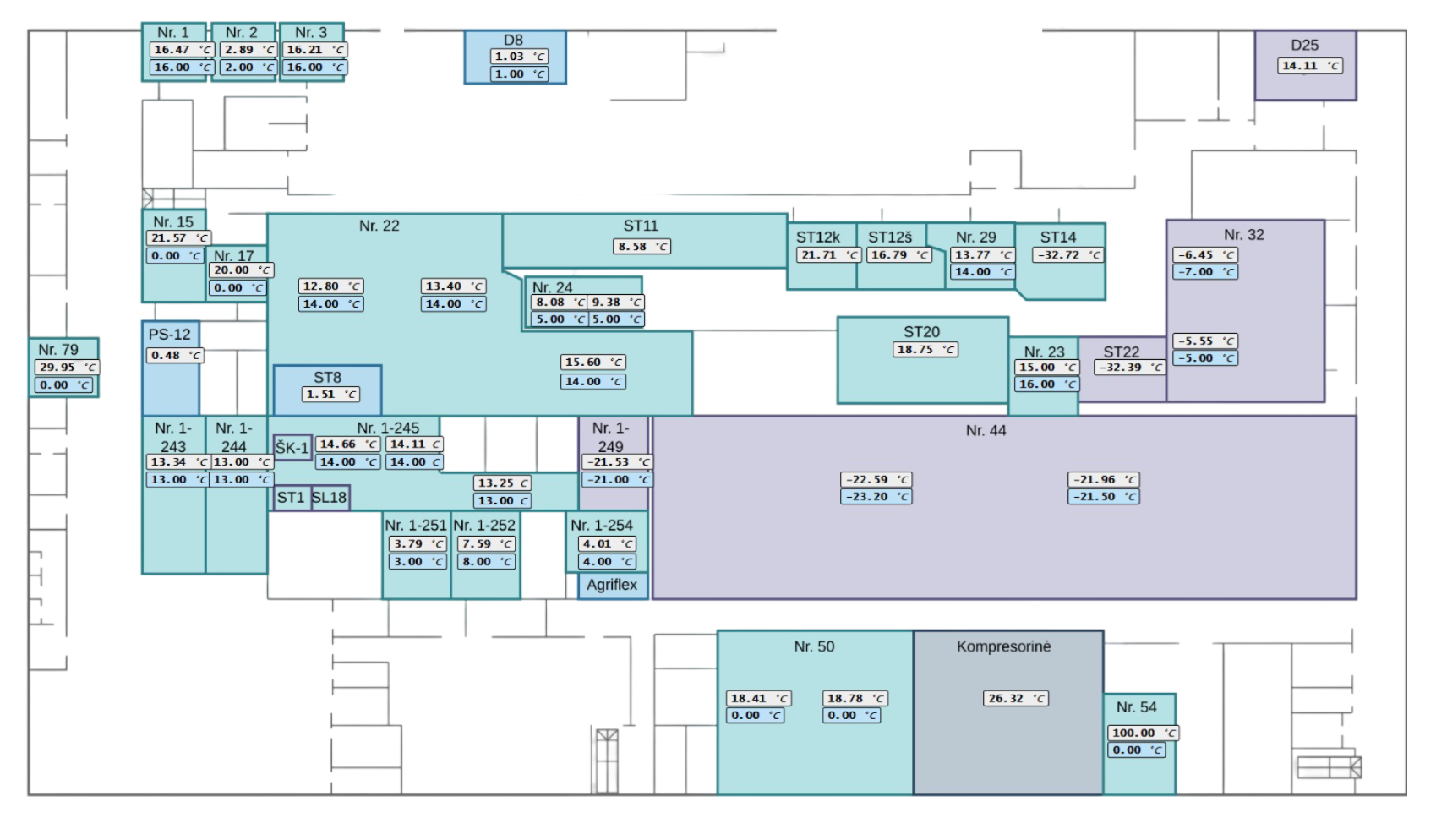
Example of a production plant
Floor plan
Intelligent Digital Twin Cloud Solution for industry

Slide 8
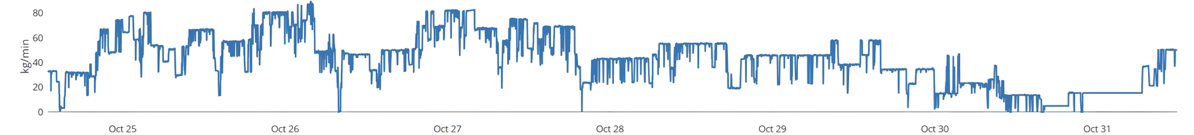
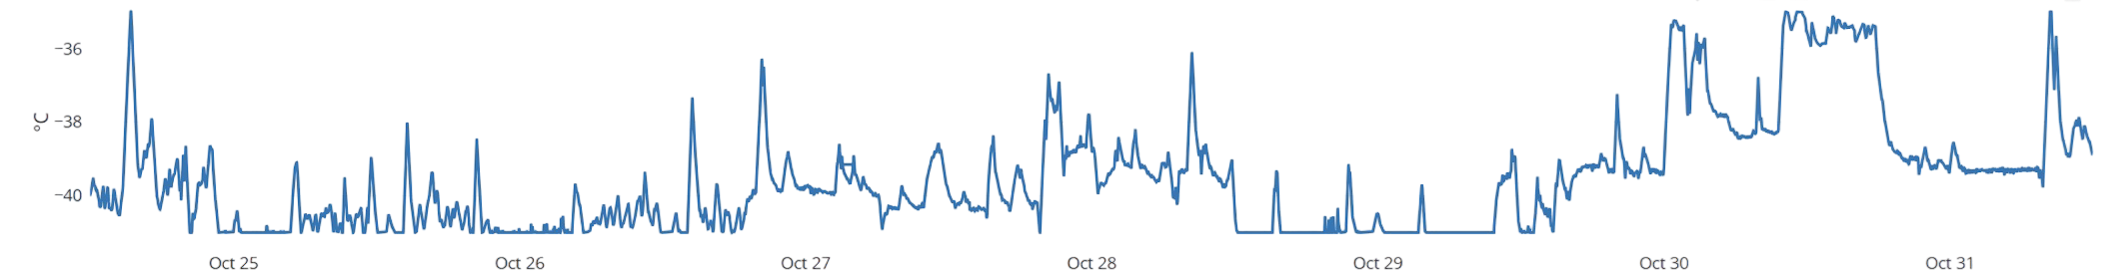
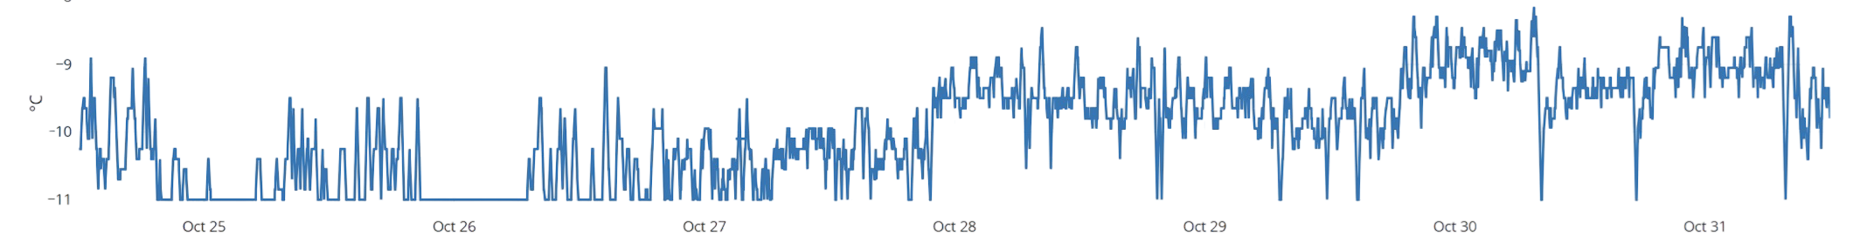
Dynamic temperature settings
based on actual refrigeration demand
Production volume
Traditional control - SCADA
Evaporation temperature setting, system -40°C
Automated control by Digital Twin
Intelligent Digital Twin Cloud Solution for industry
Traditional control - SCADA
Automated control by Digital Twin
Evaporation temperature setting, system -10°C

Slide 9
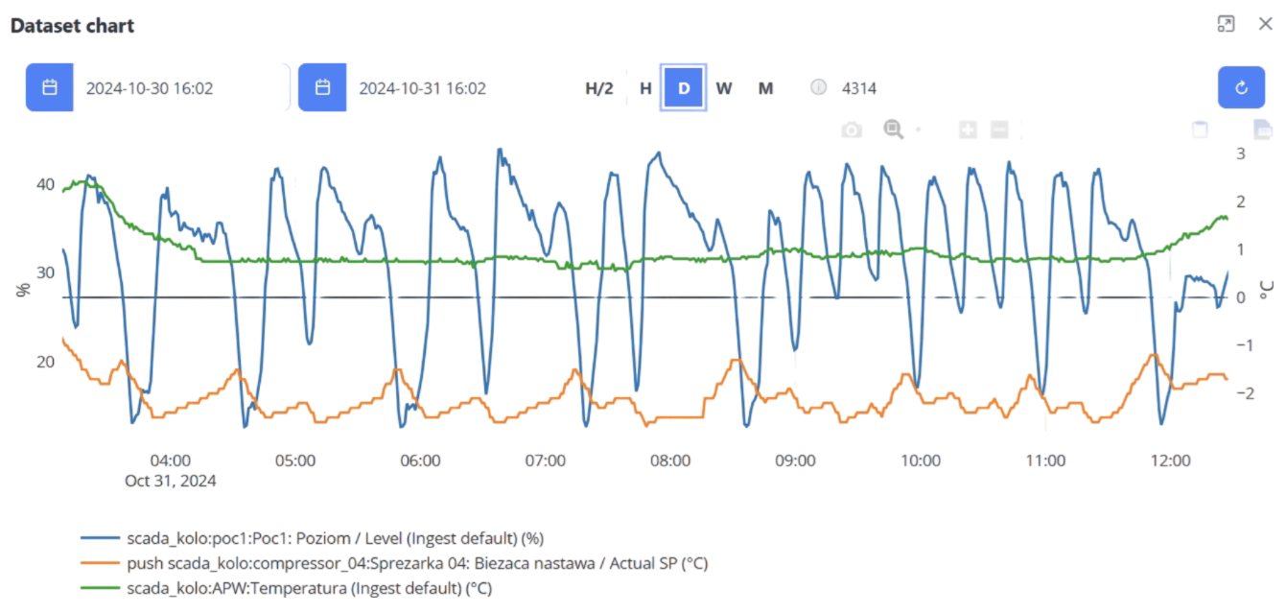
Simple analysis of parameter dependency
Any component of the refrigeration system, any date or time of day
Intelligent Digital Twin Cloud Solution for industry

Slide 10
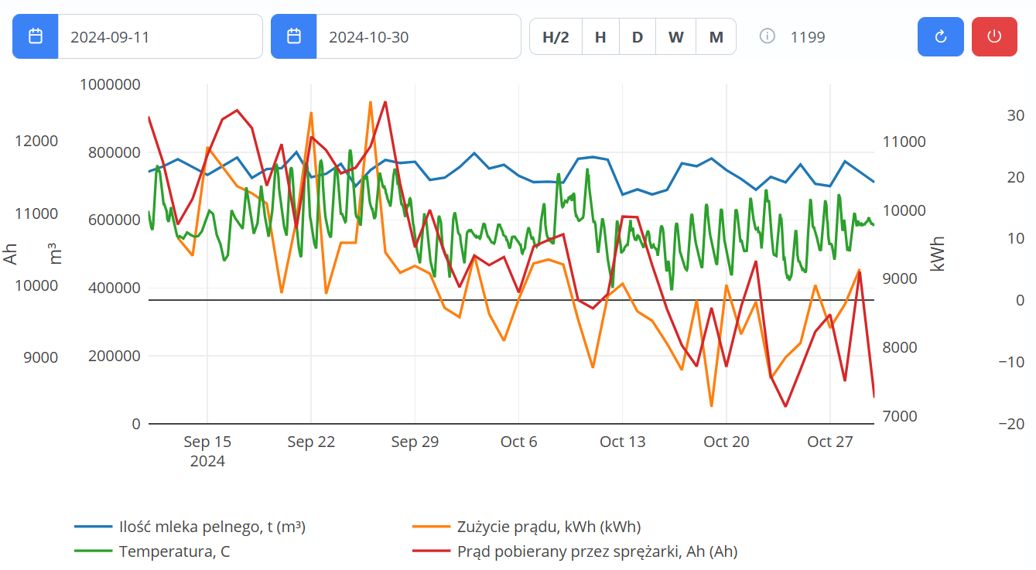
The process of training a Digital Twin
Electricity consumption declines daily, production stable
Intelligent Digital Twin Cloud Solution for industry

Slide 11
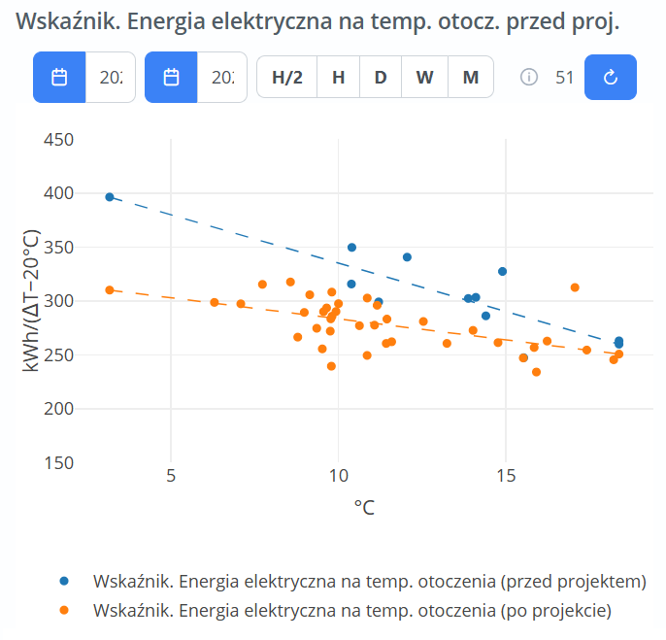
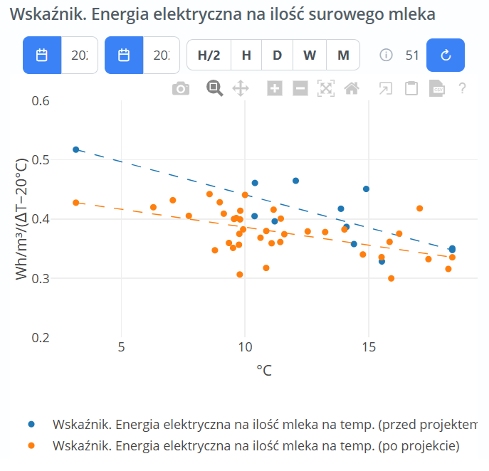
Process efficiency, before and after
Process efficiency before and after implementing Digital Twin
Przed
Po
Intelligent Digital Twin Cloud Solution for industry

Slide 12

Energy consumption, before and after
Electricity consumption before and after implementation of Digital Twin
100%
Total energy consumption of the plant
70%
Consumption of the refrigeration system “before”
55%
Consumption of the refrigeration system “after”
Intelligent Digital Twin Cloud Solution for industry

Slide 13
The WOW effect!
Immediate effect of efficiency increase once Digital Twin starts automatic system control
-37.3%
-19.6%
Meat industry
Dairy industry
Reduction of electricity consumption of refrigeration system (-40°C i -10°C)
Decrease of electricity consumption by 1 level refrigeration system (-6°C)
Intelligent Digital Twin Cloud Solution for industry
? %
16.6%
-2.9%
Malt production
Biomass boilers
Your industry
Increased production efficiency by reducing drying time
Reduction in annual biomass consumption
How much can your company save by employing Digital Twin?

Slide 14


Let's talk!
Intelligent Digital Twin Cloud Solution for industry
Learn how your company can benefit from the Intelligent Digital Twin solution!
ENERGY ADVICE
SPONSOR
FORUM MIĘSNE TECHNOLOGIE 2024

