Slide 2
Digital Twin of refrigeration system
+48 696 555 068
zilvinas.salialionis@dween.com
dween.com
Zilvinas Salialionis, DWEEN

Slide 3



Industry Revolution 4.0
How does it change the World?
01
02
03
Operational Efficiency
Regulation
Digitalization / Big Data
Avoidance of human errors, quality and speed of control, demand based optimal production scenario
Significant impact on the economy, transformation of the workforce skill sets
Large, complex data sets, difficult to process and analyze using traditional methods
Realization of the digital transformation of the field, delivering real-time decision making, enhanced productivity, flexibility and agility to revolutionize the way companies manufacture, improve and distribute their products.

Slide 4



Cognitive limitations
How many variables should be taken into account?
01
02
03
Human brain
Excel Solver
Distributed Control System
4 variables are difficult; 5 are nearly impossible
Graeme S. Halford, Rosemary Baker, Julie E. McCredden (University of Queensland ) and John D. Bain (Griffith University)
Microsoft Excel Solver has a limit of 200 decision variables
Distributed Control System (DCS) of Waste burning Power plant may have 7,265 or more measuring points
DWEEN is a cloud-based Digital twin solution that has no hardware or software limitations. An unlimited number of variables can be continuously monitored and tracked over time, and data-driven decisions can be made not only based on the actual reading of a parameter, but also on how it has evolved over time, depending on a range of other settings or readings.

Slide 5
Dween products family
Automatic control solutions for Dairy industry
01
02
03
DWEEN ^{Cold}
DWEEN ^{Dry}
DWEEN ^{Air}
Cuts industrial refrigeration electricity consumption by 10-30%
Reduces energy consumption in product drying, increasing productivity by up to 16%
Cuts indoor ventilation, heating, and cooling energy consumption by 10-15%
Dween is a cutting-edge digital twin solution designed to enhance energy and technology efficiency of industrial companies. By creating an identical, cloud-based replica of your technological process, Dween simulates real-life conditions, identifies areas for improvement, and optimizes control meeting the actual energy demand.

Slide 6



Intelligent Digital Twin
Cloud Solution, designed to increase industrial process energy efficiency and reduce resource consumption through continuous monitoring and automatic process control according to real time data.
Cuts industrial refrigeration electricity consumption by 10-30%
Hardware vendor independent
No additional equipment required

Slide 7
DWEEN ^{Cold} solution
Benefits
01
02
03
Intelligent automatic control of the refrigeration system
Comprehensive real-time performance evaluation
Reports, visualization of operational data
Advanced evaporation temperature and pressure control
Adaptation of Chilled Water temperature to actual production demands
Glycol circuit control
Efficiency of the machinery
Temperatures of the medias
Temperatures in the facilities
Main dashboard
Real time data
Historical data (2 years)
Comprehensive real-time evaluation of complex refrigeration system efficiency can be accessed online through a simple web viewer. The system with a high level of security for different types of users.
The solution is compliant with the NIS 2 directive.

Slide 8
DWEEN ^{Cold} solution
Additional benefits
Reduction of refrigeration energy consumption
Adoption of the refrigeration process to variable production capacity
Reduction of variable production costs
Extended life of refrigeration equipment
24/7 KPI tracking
Historical usage data to enable production tracking
Lower maintenance and repair costs through data-driven decisions
Easier training of new personnel
Reduced CO₂ emissions
Sustainability

Slide 9

DWEEN ^{Cold} solution
Return on investment expected in
less than 1 year

Slide 10
Management of refrigeration system of
OSM Koło
+48 696 555 068
zilvinas.salialionis@dween.com
dween.com
Zilvinas Salialionis, DWEEN

Slide 11

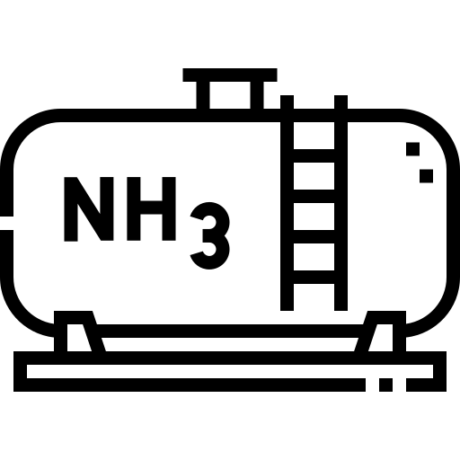

DWEEN ^{Cold} solution at OSM Koło
Refrigeration system
01
02
03
Machine room
Zbiornik amoniaku
Chilled water tanks
Compressors JCi Sabroe 151
Controllers JCi Unisab III
Electrical power 4x160 kW
Cooling capacity 4x600 kW
Capacity 8 t
Min. temp. -8 °C
Water capacity 2x70 t
Accumulation capacity 2x3.7 MW
The main refrigerant in the plant is chilled water, which is used in varying amounts in different production processes. Company completely upgraded its refrigeration system in 2011, and the system was operated by operators until 2024.
DWEEN Cold's Digital Twin solution is responsible for automated control of refrigeration energy production from October 2024.

Slide 12
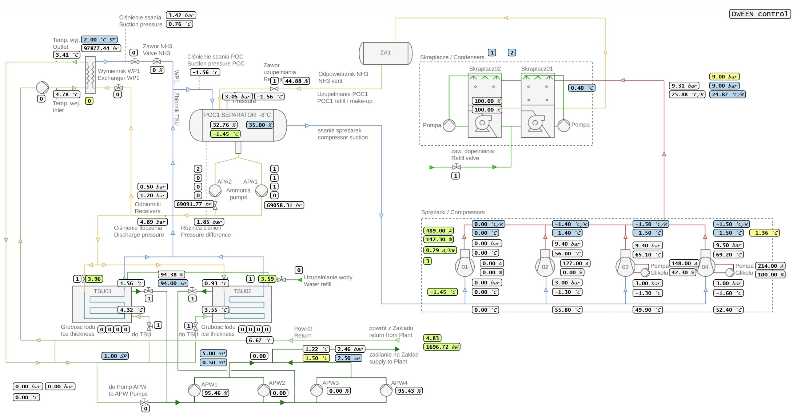
SCADA system view

Slide 13
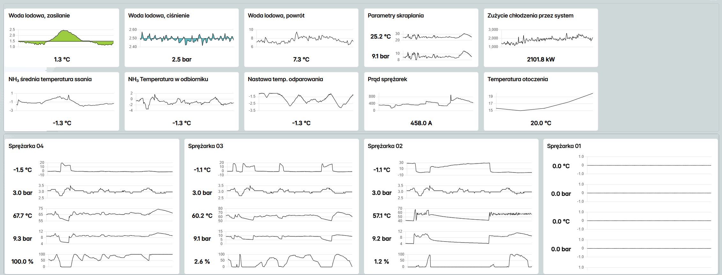
Main dashboard

Slide 14
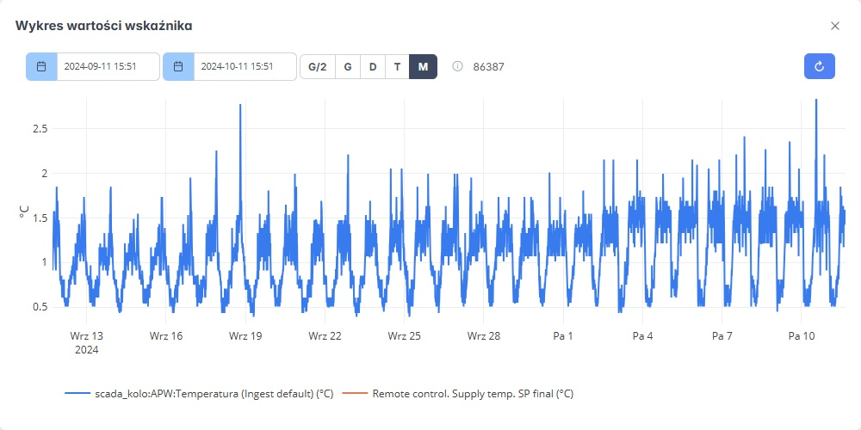
Chilled water - supply
Chart „BEFORE“

Slide 15
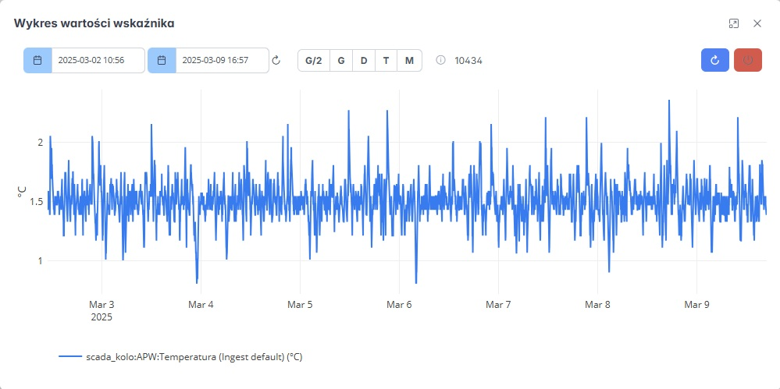
Chilled water - supply
Chart „AFTER“
Why?
Chilled water temperature stabilization

Slide 16
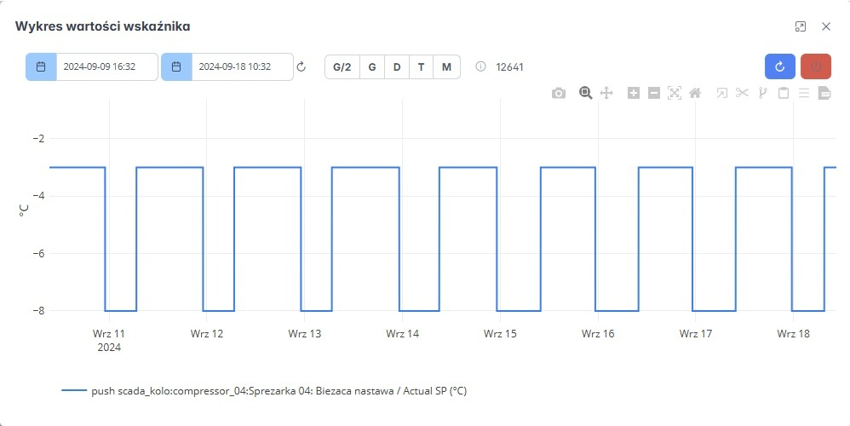
Chilled water – is ice accumulation necessary?
Chart „BEFORE“

Slide 17
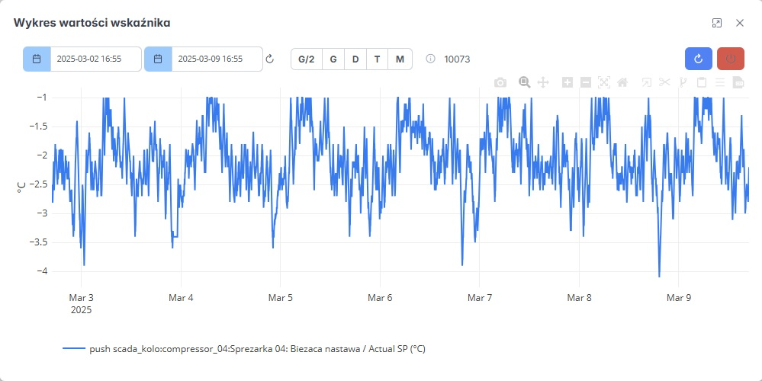
Chilled water - dynamic temperature control
Chart „AFTER“
Why?
Reduced system load
Reduced power consumption

Slide 18
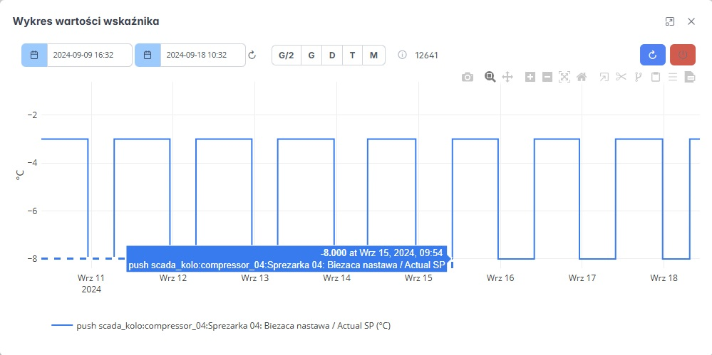
Electricity price peaks
„Cheap“ electricity:
from 23:00
till 7:00
Why?
Avoiding human errors

Slide 19
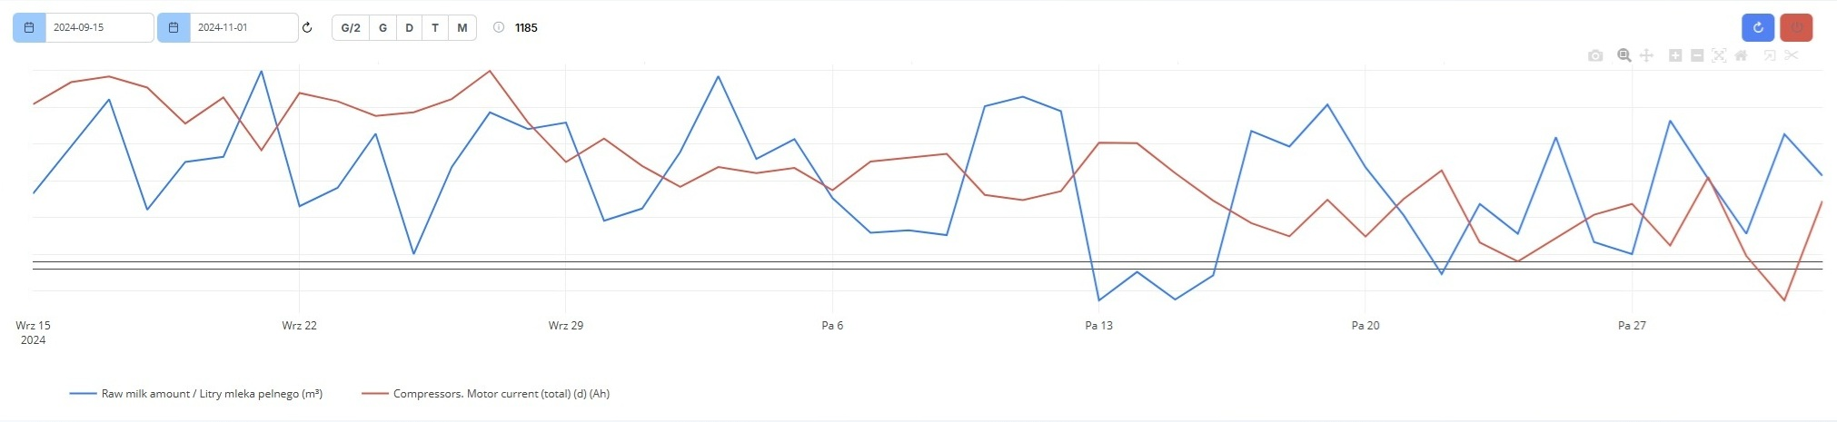
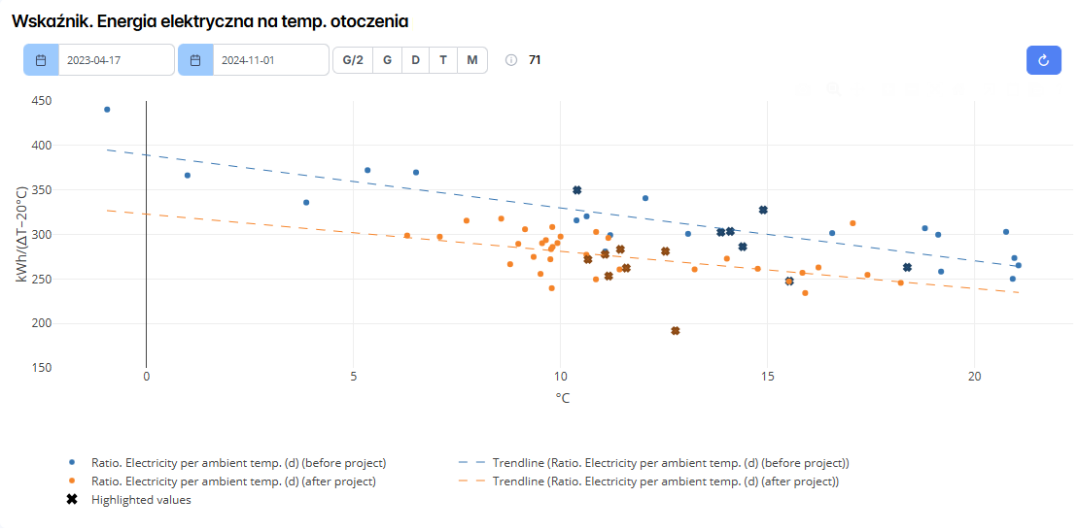
Reduction of electricity consumption
-15%
In just 2 months

Slide 20
Thank You!
Come and meet us at DWEEN booth
+48 696 555 068
zilvinas.salialionis@dween.com
dween.com

