Slide 2
Automated control of Biomass boiler
+370 677 67695
zilvinas.salialionis@dween.com
dween.com
Zilvinas Salialionis, DWEEN

Slide 3



Industry Revolution 4.0
How does it change the World?
01
02
03
Operational Efficiency
Regulation
Digitalization / Big Data
Avoidance of human errors, quality and speed of control, demand based optimal production scenario
Significant impact on the economy, transformation of the workforce skill sets
Large, complex data sets, difficult to process and analyze using traditional methods
Realization of the digital transformation of the field, delivering real-time decision making, enhanced productivity, flexibility and agility to revolutionize the way companies manufacture, improve and distribute their products.

Slide 4



Cognitive limitations
How many variables should be taken into account?
01
02
03
Human brain
Excel Solver
Distributed Control System
4 variables are difficult; 5 are nearly impossible
Graeme S. Halford, Rosemary Baker, Julie E. McCredden (University of Queensland ) and John D. Bain (Griffith University)
Microsoft Excel Solver has a limit of 200 decision variables
Distributed Control System (DCS) of Waste burning Power plant may have 7,265 or more measuring points
DWEEN is a cloud-based Digital twin solution that has no hardware or software limitations. An unlimited number of variables can be continuously monitored and tracked over time, and data-driven decisions can be made not only based on the actual reading of a parameter, but also on how it has evolved over time, depending on a range of other settings or readings.

Slide 5
Dween products family
Automated control solutions for numerous industries
01
02
03
DWEEN ^{Boiler}
DWEEN ^{Waste}
DWEEN ^{Heat}
Boosts biomass boiler efficiency by 2-5%, lowering biofuel consumption
Improves combustion efficiency and asset availability, reduces CO₂ emissions and chemical use
Optimizes heat distribution networks, reducing heat energy losses by up to 15%
Dween is a cutting-edge digital twin solution designed to enhance energy and technology efficiency of industrial companies. By creating an identical, cloud-based replica of your technological process, Dween simulates real-life conditions, identifies areas for improvement, and optimizes control meeting the actual energy demand.

Slide 6



Intelligent Digital Twin
Cloud Solution, designed to increase industrial process energy efficiency and reduce resource consumption through continuous monitoring and automatic process control according to real time data.
Boosts biomass boiler efficiency by 2-5%, lowering biofuel consumption.
Hardware vendor independent
No additional equipment required

Slide 7
DWEEN ^{Boiler} solution
Benefits
01
02
03
Intelligent automatic control of the combustion process
Comprehensive real-time performance evaluation
Reports, visualization of operational data
Air volume control
Fuel dosing control
Grate movement speed control
Efficiency of the boiler(s), %
Efficiency of flue gas condenser, %
Fuel quality, MWh/t
Main dashboard
Real time data
Historical data (2 years)
Comprehensive real-time evaluation of biofuel power plant efficiency can be accessed online through a simple web viewer. The system with a high level of security for different types of users.
The solution is compliant with the NIS 2 directive.

Slide 8
DWEEN ^{Boiler} solution
Additional benefits
Increased operational efficiency / reduced biofuel consumption
Reduced operator involvement
Eliminated risk of human error and increased safety
Reduced risk of tar formation on furnace and boiler
Reduced risk of furnace contamination with ash
Reduced risk of ash melting
Reduced risk of boiler erosion
Reduced risk of boiler corrosion
Extended lifetime of equipment
Reduced amount of ash

Slide 9
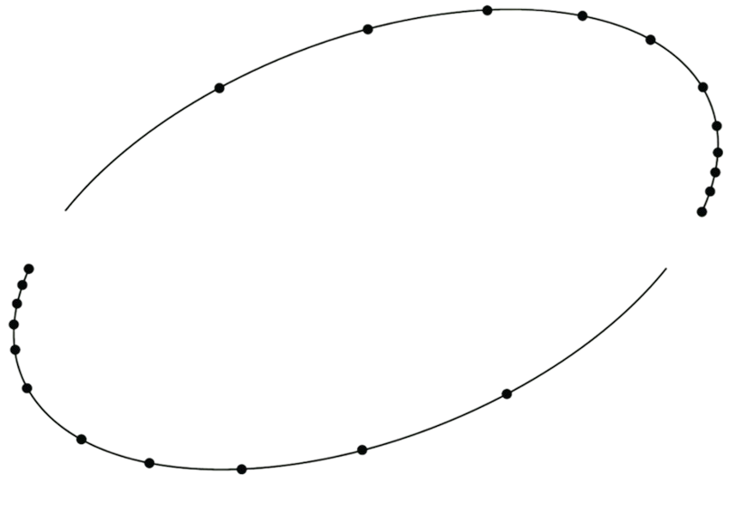
DWEEN ^{Boiler} solution
Return on investment expected in
less than 1 year

Slide 10
Biomass boiler control in MPEC Lomza
+370 677 67695
zilvinas.salialionis@dween.com
dween.com
Zilvinas Salialionis, DWEEN

Slide 11
DWEEN ^{Boiler} Digital Twin solution for MPEC Łomża
Biomass boiler K-6 at MPEC Łomża:
01
02
03
Biomass furnace
Water boiler
Condensing Economizer
Type JSC (Enerstena)
Power 14 MW
Flue gas temperature 950-1050 °C
Thermal load of grate ≤450 kW/m²
Type VHB-12.5
Rated power 12.5 MW
Water volume 52.10 m³
Operating pressure 11 bar
Type CEB 3000
Nominal power 2.4 MW
Operating pressure 5.5 bar
Municipal Heat Plant in Lomza began expanding its thermal energy plant in 2019 with a new source of heat generation (RES) using biomass (woodchip). Until 2025 biomass boiler K-6 has been controlled by operators.
DWEEN ^{Boiler} Digital Twin solution is responsible for automated control of burning process since March 2025.

Slide 12
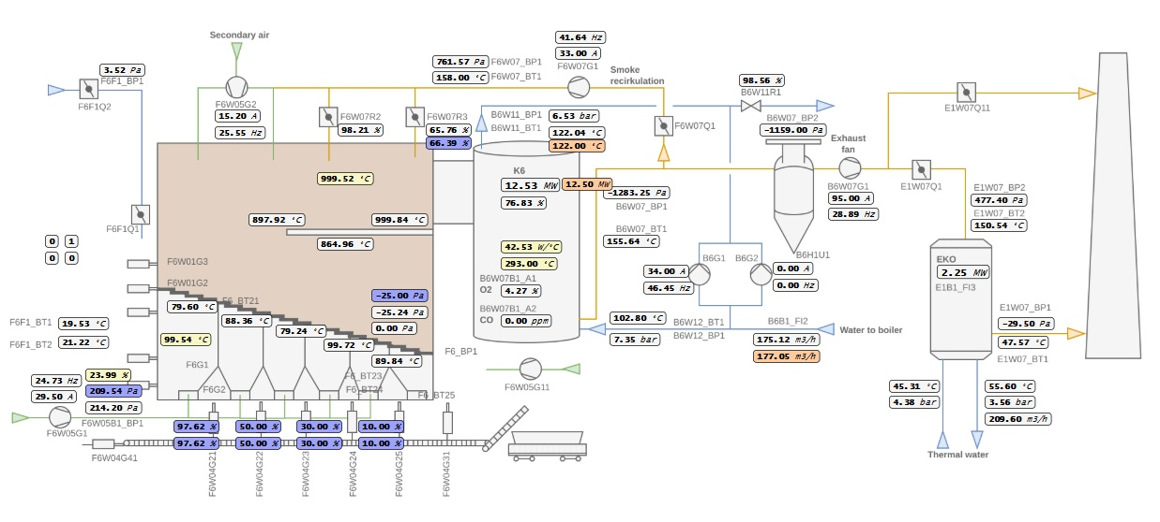
SCADA system view

Slide 13
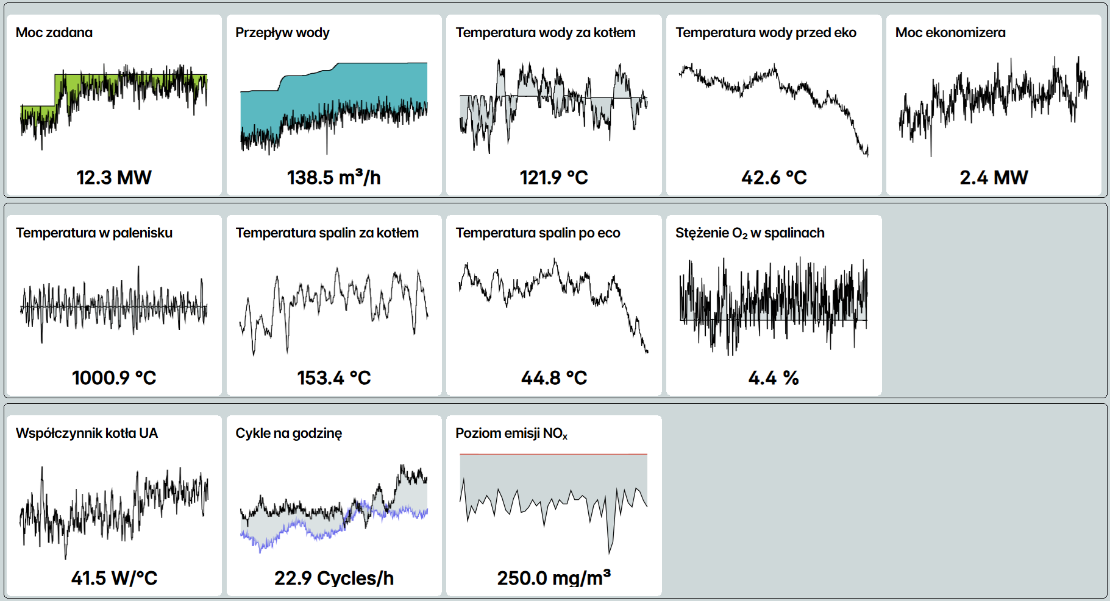
Main dashboard
Performance parameters:
Parameters of the combustion process:
Efficiency parameters:

Slide 14
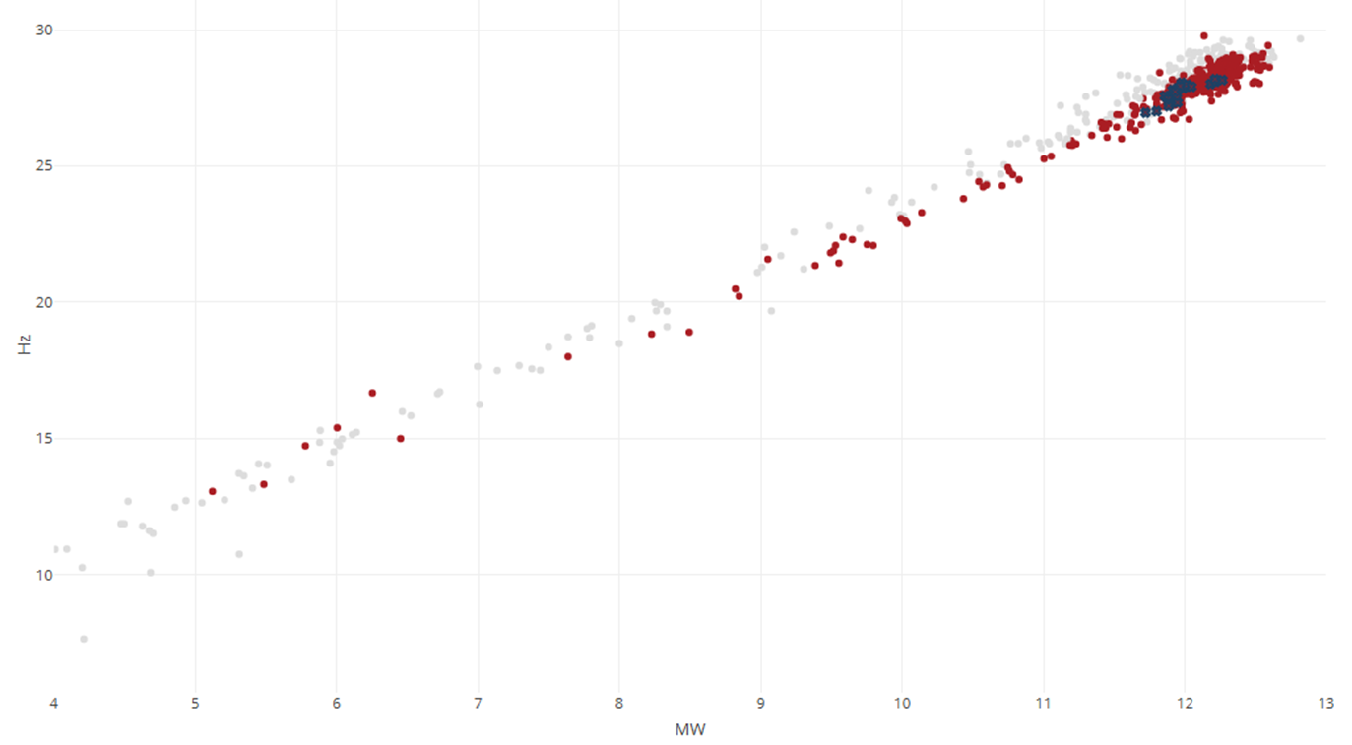
Flue gas fan
Frequency,
(lower is better)
- Enerstena control - DWEEN Boiler control

Slide 15
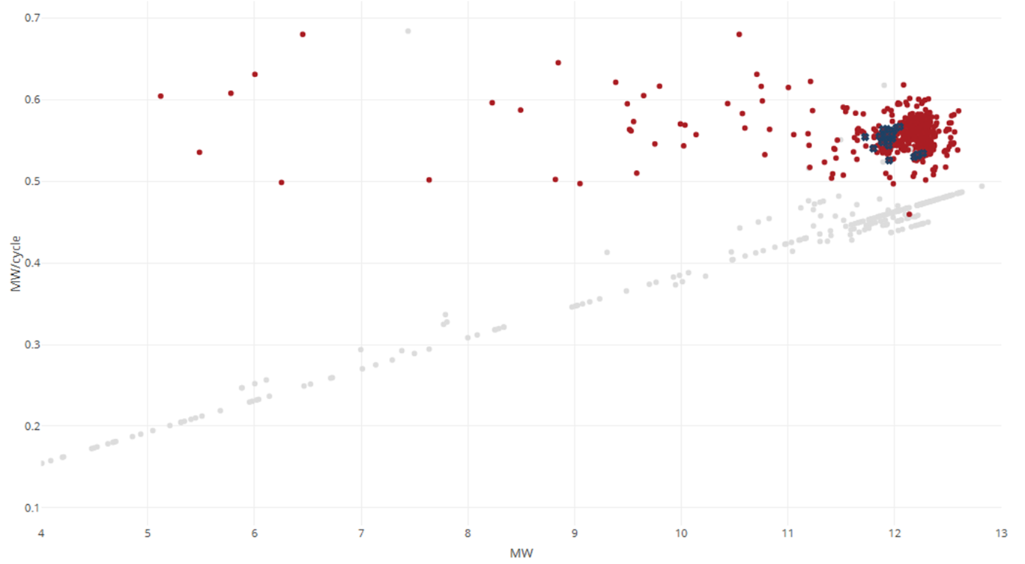
Energy production from single fuel cycle
MW/cycle,
(higher is better)
- Enerstena control - DWEEN Boiler control

Slide 16
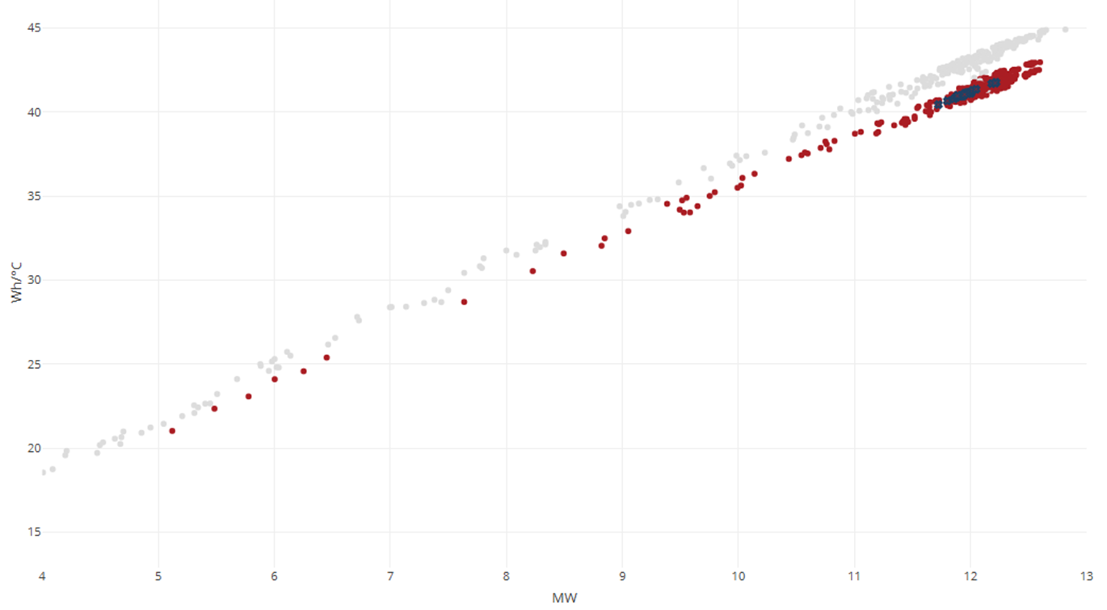
UA efficiency rating
$UA=\frac{Q}{LMTD}$
-3,5%
Efficiency rating W/°C
(lower is better)
- Enerstena control - DWEEN Boiler control

Slide 17
Zilvinas Salialionis +48 696 555 068 zilvinas.salialionis@dween.com
Want to know more? Visit DWEEN booth or get in touch to arrange personal demonstration

